Slide 1
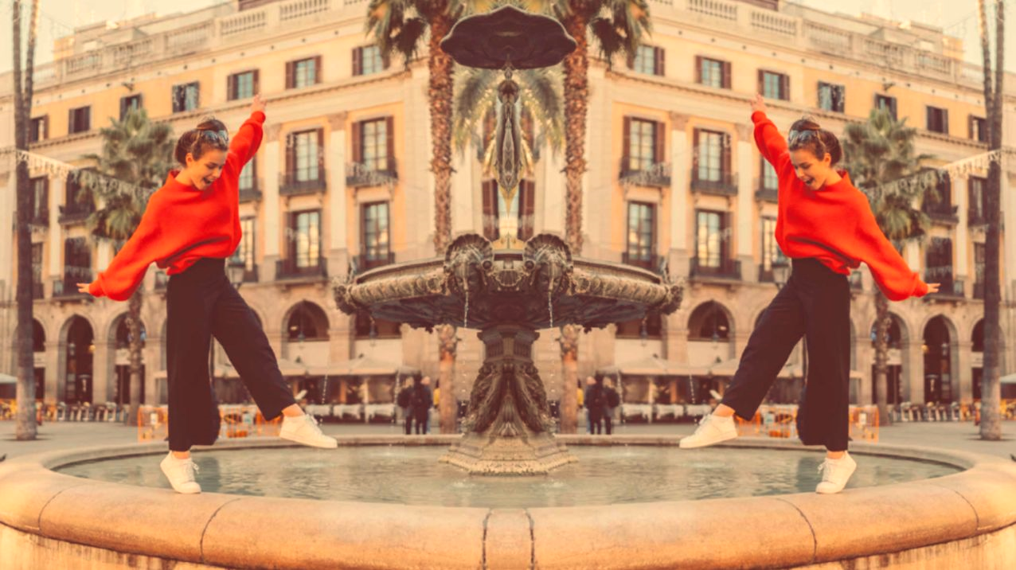


UNIT 4;
All over the map
Lesson 1; Breathtaking

Slide 2
Do you know the meaning of these expressions?
prirodni okoliš
umjetni okoliš/okruženje
brana
dina
granica
zadivljujuć
veličanstven
ogroman
pristanište
novčanica
upregnuti
neovlašteno ući
blistav
idiličan
prizor
natural environment
man-made environment
a dam
a dune
a border
captivating
majestic
vast
a pier
a banknote
a harness
to trespass
dazzling
idyllic
a sight
Is there anything that takes your breath away in your environment?
BREATHTAKING

Slide 3
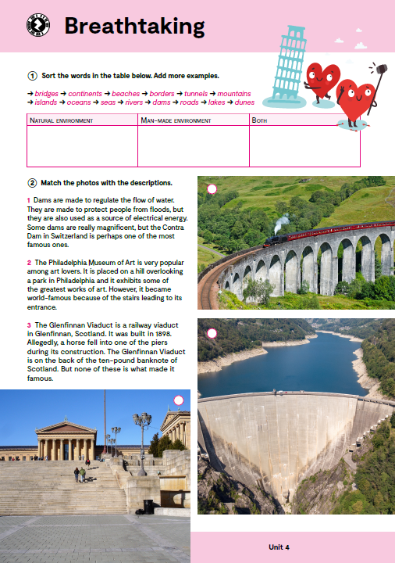
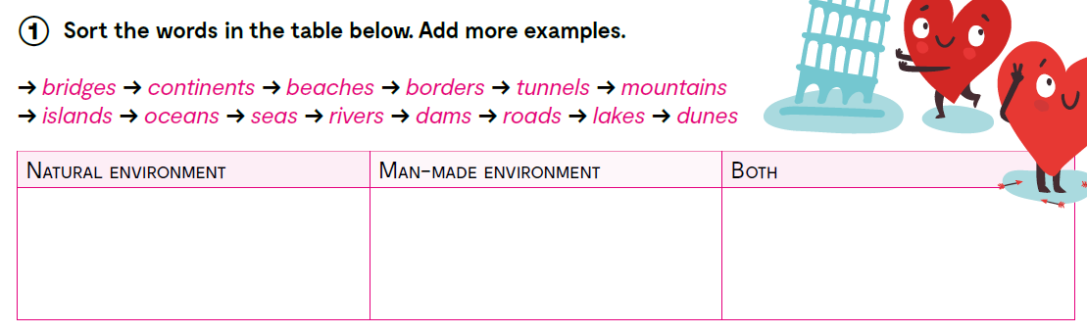
continents
bridges
beaches
borders
mountains
tunnels
oceans
seas
rivers
dams
roads
islands
lakes
dunes
You can do this task online as well.
https://wordwall.net/resource/25278645

Slide 4

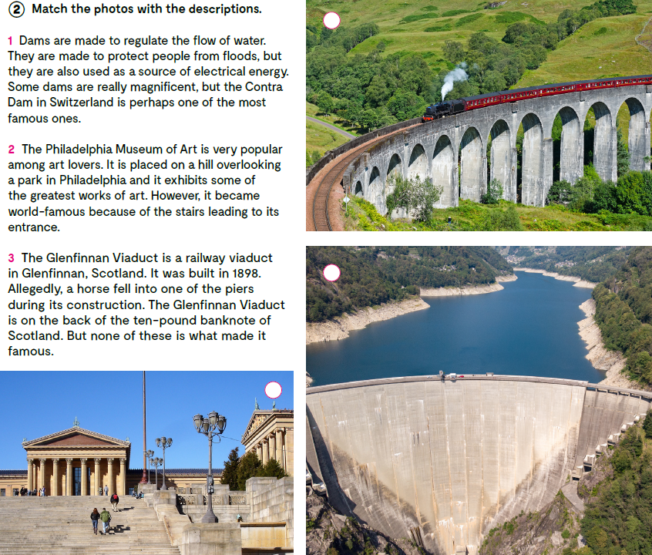
3
Match the photos with the descriptions.
1
Are the sights in the photos natural or man-made?
Are you familiar with these sights?
Have you seen them before? Which one?/Where?
2

Slide 5
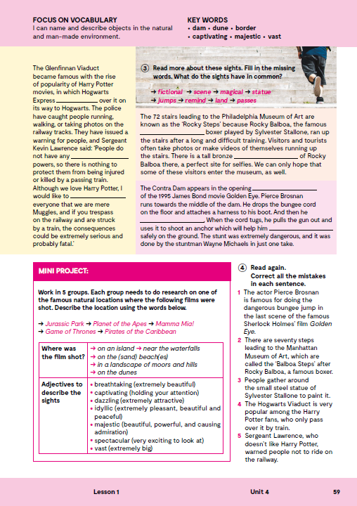
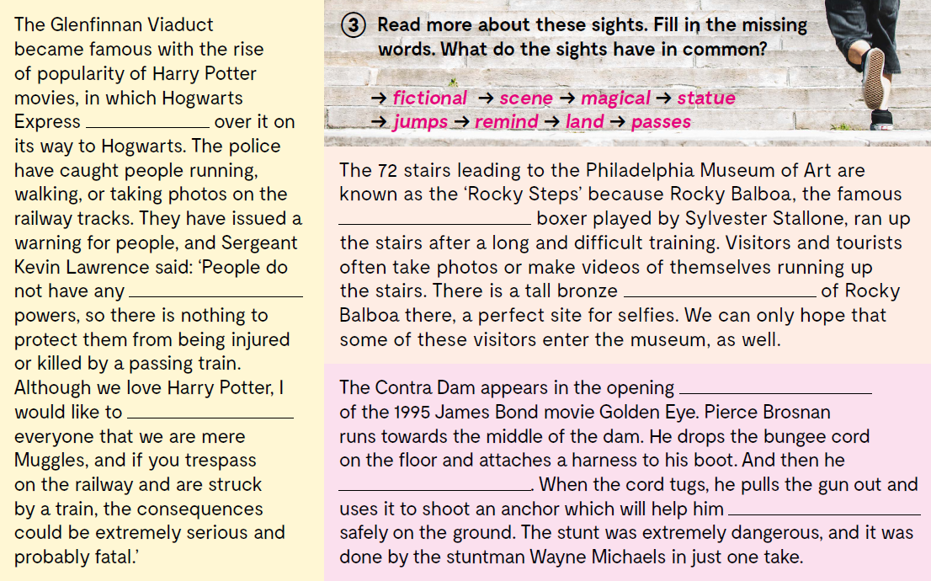
Read more about these sights. Fill in the missing words. What do the sights have in common?
passes
fictional
magical
statue
scene
All of these sights appeared in famous movies: Harry Potter, Rocky, James Bond: Golden Eye.
remind
jumps
land
https://youtu.be/N7cGK0P8rMM

Slide 6

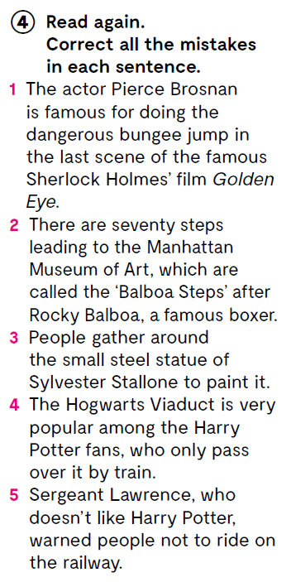
Read again. Correct all the mistakes in each sentence.
1 The actor Pierce Brosnan is famous for doing the dangerous bungee jump in the first scene of the famous James Bond film Golden Eye.
2 There are seventy-two steps leading to the Philadelphia Museum of Art, which are called the ‘Rocky Steps’ after Rocky Balboa, a famous boxer.
3 People gather around the tall bronze statue of Rocky Balboa to take photos and make videos.
4 The Glenfinnan Viaduct is very popular among the Harry Potter fans, who have been caught running, walking, and taking photos on the railway tracks.
5 Sergeant Lawrence, who loves Harry Potter, warned people not to trespass.

Slide 7
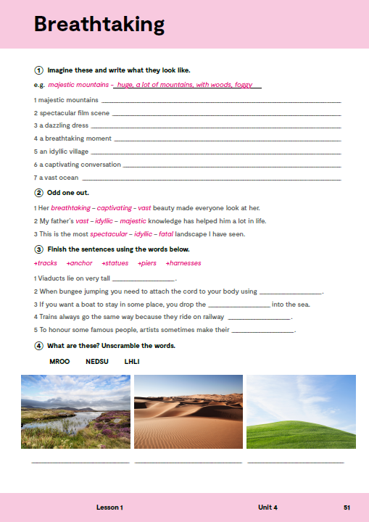
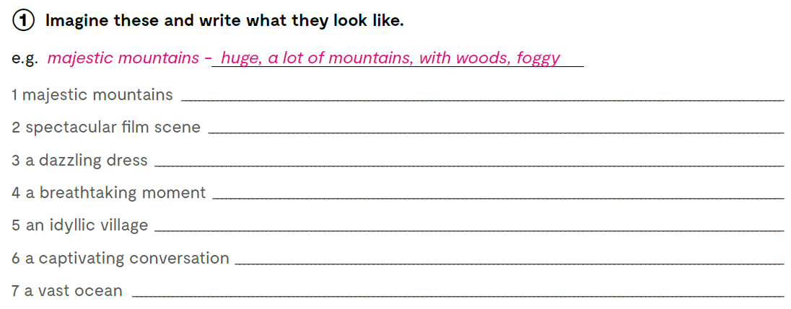
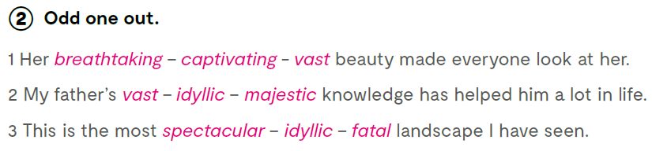

Slide 8

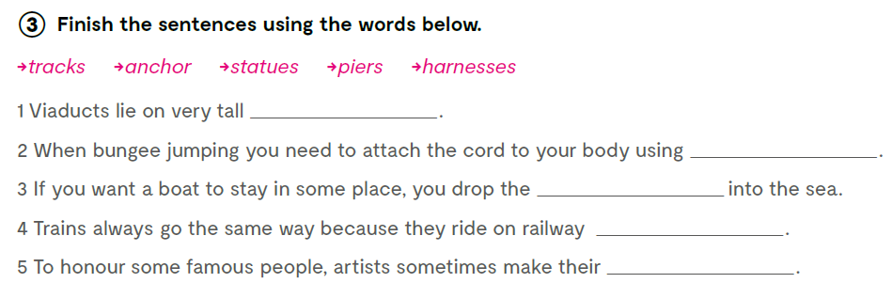
piers
harnesses
anchor
tracks
statues

Slide 9
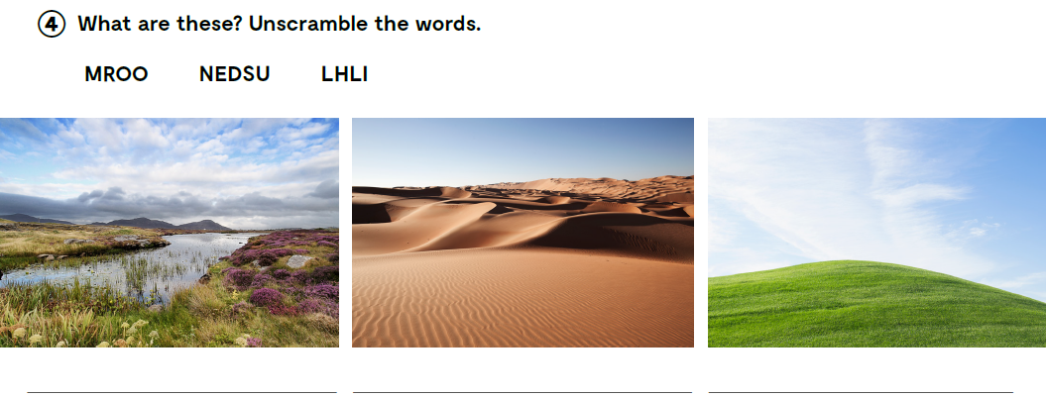
moor = bara, močvara
dunes
hill
Check what you have learnt.
https://wordwall.net/play/12880/099/960

Slide 10
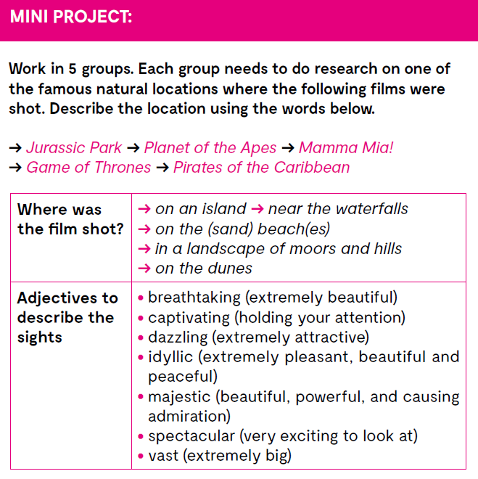
Check what you have learnt.
https://wordwall.net/resource/25284299

Slide 11

Open the following link and then click on LEARN MORE!
https://www.e-sfera.hr/dodatni-digitalni-sadrzaji/7e62f9e5-3e58-4918-bd78-3ce806f5ba5d/
Where people and nature meet in Croatia
Read the texts and do the tasks.

Slide 12
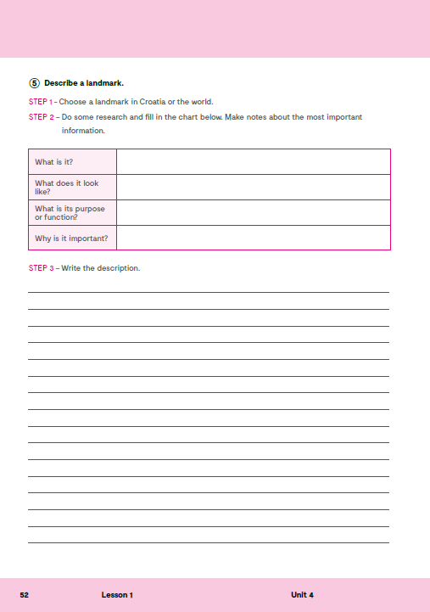
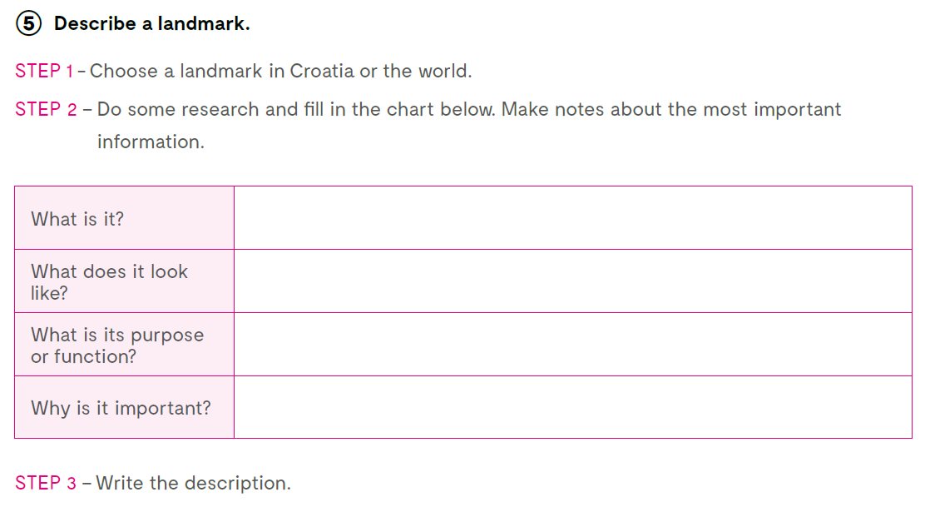
workbook, page 52.

